Slide 1
PikeOS 4.2
Safe and Secure Multi-Core RTOS
SYSGO AG
2018

Slide 2
PikeOS RTOS
RTOS and Type 1 Hypervisor Design
  RTOS with Separation Microkernel – MMU Based
  Hard Real Time
  Supporting Hardware or Software Virtualization
  Aerospace, Automotive, Transportation, Industrial and Medical Vertical Coverage
Features
  Robust Partitioning
  Time and Space Separation
  Multi-Core Resource
  Management
  Guest OS Support
  Time Partitioning
  by Core
  Multiple levels of
  Criticality and
  Security through
  Robust Partitioning
  and Separation.
ARINC
653
AUTO
SAR
POSIX
ADA
Linux
PikeOS RTOS (System Services)
Hypervisor Separation Microkernel

Slide 3
PikeOS Architecture
ARINC
653
Auto
SAR
POSIX
ADA
Linux
PikeOS RTOS (System Services)
User
Space
PikeOS Hypervisor & Separation Microkernel
Kernel
Space
Boot Loader
< Custom option for Safety & Security
Hardware Devices

Slide 4
PikeOS Partition Types - Guest OS
General Purpose
  PikeOS Native
  POSIX – PSE51/52 (C++ 2011)
  Linux
  Real-time Java
Aerospace
  ARINC 653
  Ada (ZFP, Cert or Ravenscar Profile) –
  POSIX Cert
Automotive
  AutoSAR
  AutoSAR Adaptive
Transportation
  Ada (ZFP) – Railway

Slide 5
Architecture Support
PowerPC
  e500, e500mc, e5500, e6500
  PowerQUICC III, QorIQ Px and T1, T2, T4
Intel x86
  32 and 64 bits
ARM V7, 32 bits
  Cortex-A7, Cortex-A8, Cortex-A9, Cortex-A15
  i.MX 6, i.MX 7
  Xilinx Zynq 7000
  TI OMAP 35xx, OMAP 44xx
  RENESAS R-car H2
ARM V8, 64 bits
  Cortex A53/A57/A72
  Xilinx UltraScale, JUNO ARM, RENESAS R-car H3
  LS1043, LS1046, i.MX8 (soon)
SPARC
  LEON 3, LEON 4

Slide 6
PikeOS 4.2
Multi-Core Processor Management
SYSGO AG
2018

Slide 7
PikeOS – SMP Multi-Core Management
Multi-Core
  PikeOS provides separation of partitions by Time, Space and by Processor core
  User defined partition schedule schemes might provide specific cores for either safety or security critical partitions.
  Scheduling allows cache clearance policies depending on the criticality of the partitions.
ARINC
653
PikeOS
NATIVE
POSIX
Linux
Core 3
Core 2
Core 1
PikeOS RTOS (System Services)
Hypervisor Separation Microkernel
Core 0
Hardware Devices
Critical
Partition
Separation
By Core
Major
Time
Frame
Window
Notes:
Debugging: not only one but multiple applications
Based on well known and established standard gdb

Slide 8
PikeOS 4.2
Security
SYSGO AG
2018

Slide 9

RTOS Considerations – PikeOS RTOS
PikeOS Hypervisor
  RTOS with Separation Microkernel (MMU only)
Multicore Resource Management
Time and Space Separation
Robust Partitioning
Guest OS Support
Multiple Levels of
Criticality to reduce
cost of certification
Multiple Independent
Levels of Security
Airbus Security Assurance
Requirement
Level 4 compliant
ARINC
653
Auto
SAR
POSIX
ADA
Linux
PikeOS RTOS (System Services)
Hypervisor Separation Microkernel
Hardware Devices
http://euromils.eu/index.html

Slide 10
Security by design with smart partition handling
Secure Life Cycle
ISO 27000
Common
Criteria
Root of Trust
App
App
App
App
Sec. Update
Secure Com
Cloud
Secure Architecture
(S)OTA
Secure
Boot
Secure Development
Security by Design

Slide 11
PikeOS 4.2
Certification
SYSGO AG
2018

Slide 12
Certification Standards
International
(Generic)
Medical
Process
Industry
Avionic
IEC 61508(-3)
Functional safety of electrical / electronic / proprammable electronic safety related systems
IEC 62304
Software for medical equipment
IEC 61511
Safety systems for the process industry sector
DO 178B/C
Software considerations in airborne systems
ISO/IEC 15504
SPICE ( Automotive SPICE
Machines
Railway
Nuclear Power
ISO/IEC 12207
Software lifecycle processes
ISO 13849
IEC 62061
Machine safety
EN 50128
Software for railway equipment
IEC 60880
Nuclear plants – Software aspects of process control
Gas Detection
Automotive
Security
EN 50271
EN 50402
Functional safety of das measurement and detection equipment
ISO DIS 26262-6/-8
Functional safety of “road vehicles”
IEC 15408
Common Criteria for IT Security Evalutation
IEC 62443
Industrial network and system security

Slide 13
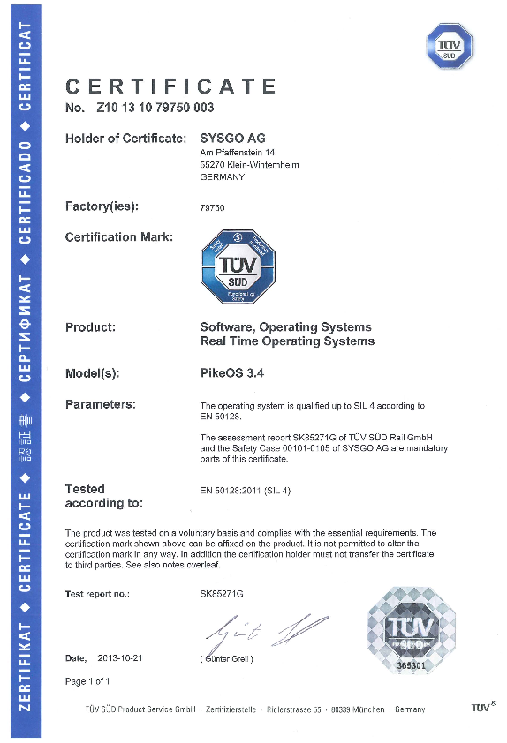
PikeOS - Certified Safety and Reliability
PikeOS certification standards and levels:
DO-178B DAL B – (DAL A on going)
IEC 61508 SIL3/4
EN 50128 / 50129 SIL4
ISO 26262 ASIL D
Common Criteria EAL 3+ Certified, 4+ ongoing
SYSGO certification experience:
Over 14 years experience in software certification
75% of the engineering staff has experiences in
certification projects
Highest level of software certification for PikeOS
Reference certification customers:
Airbus, Rockwell Collins, Rheinmetall Defence Electronics, Samsung SDS
Notes:
Verification of Realtime-Operating System
A400M-LMWS-B2 System Software Development with PikeOS (Level B)
Customer: MEN/RDE
State: SOI-3 passed
Verification of CORE Avionics Platform, TSO 2003
LynxOS, Level A
Customer: Rockwell Collins
State: finished
Verification of AFDX Protocol Stack for Engine Monitoring Systems
Boing 787, Level C
Customer: Vibro Meter
State: finished
Verification of PikeOS+POSIX (ASFC)
Level C
Customer: Airbus, A350
State: in progress
Verification of AFDX Protocol Stack for Engine Monitoring Systems
for Airbus A350, Level C
Customer: Vibro Meter
State: in progress

Slide 14
PikeOS 4.2
DEVELOPMENT CYCLE & TOOLS
SYSGO AG
2018

Slide 15
PikeOS - Development Cycle
Application Domain
Board Support Package Domain
Application Domain
PikeOS API
Header Files
PSP
PikeOS API
Header Files
Application
Source Code
Application
Source Code
PikeOS PSP
Header Files
Ext. FP
Sources
PikeOS API
Header Files
PikeOS API
Libraries
PikeOS PSP
Library
PikeOS API
Libraries
PikeOS CDK
PikeOS CDK
PikeOS CDK
PikeOS CDK
PikeOS API
Libraries
Personality
Libraries
Application
Libraries
PikeOS
Kernel Library
Application
Data Files
Config Data
Application
Data Files
Application
Binary
Application
Binary
Kernel
Binary
Ext. FP
Binary Files
Application
Data Files
Ext. FP
Binary Files
Integration Domain
PikeOS System
Software Module
PikeOS Utilities
PikeOS Utilities
Properties and
Tags
VMIT
PikeOS Configuration
Builder
PikeOS ROM Image
Builder
Downloadable
Rom Image

Slide 16
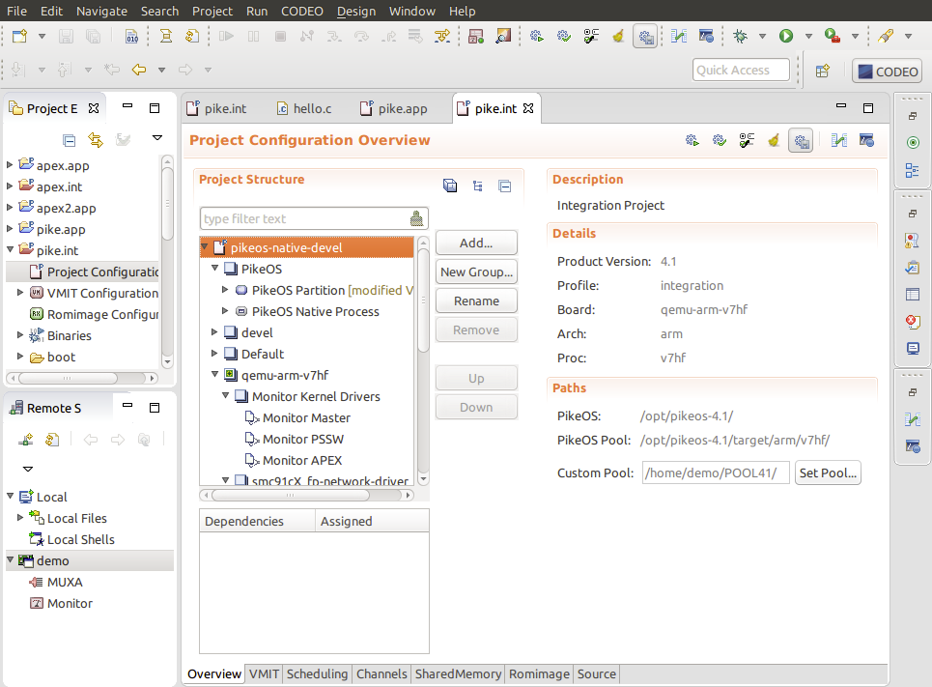
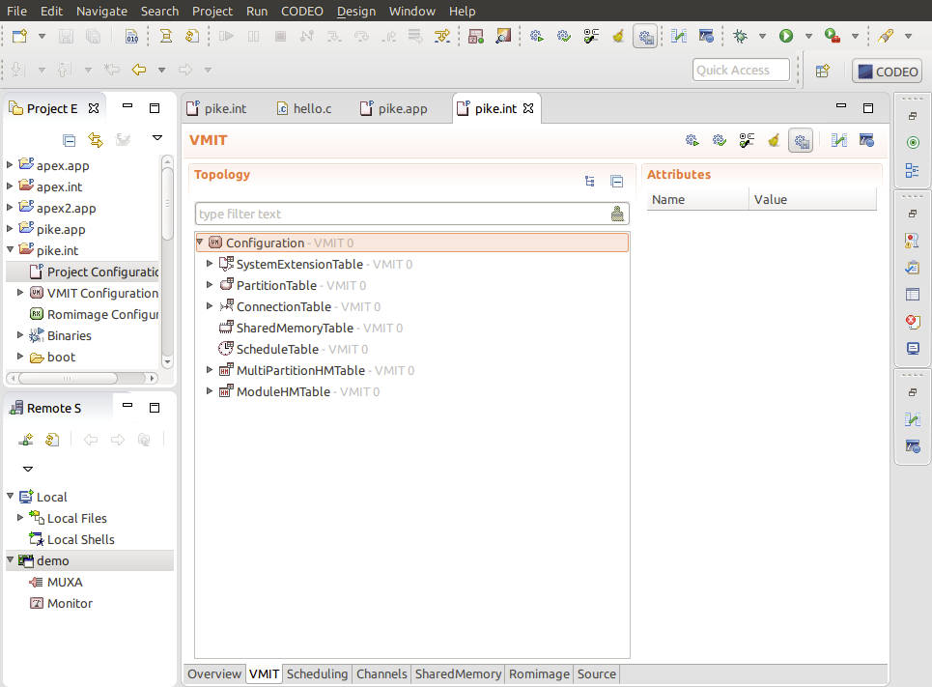
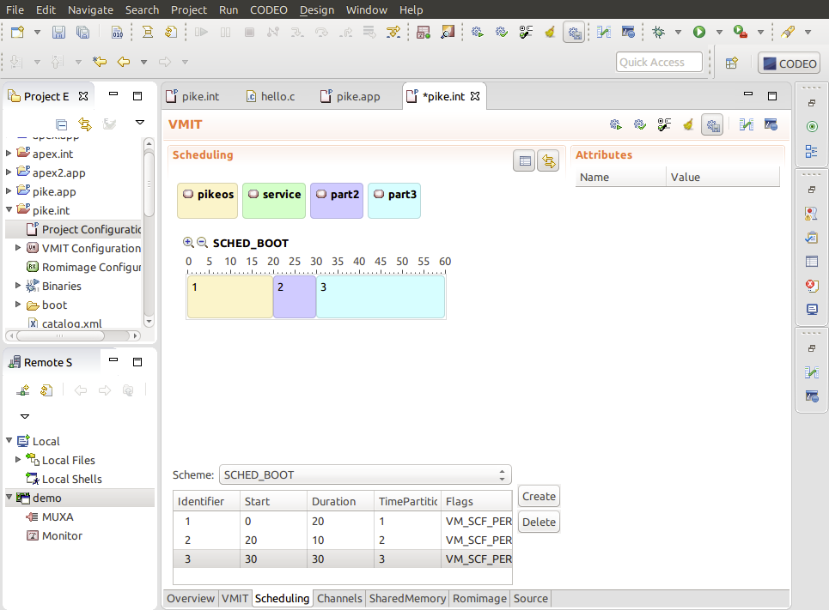
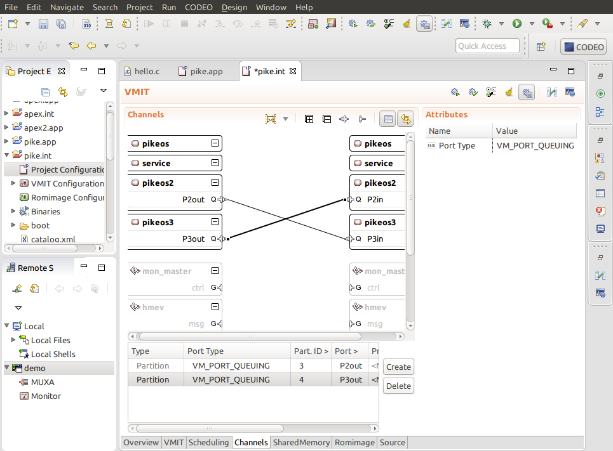
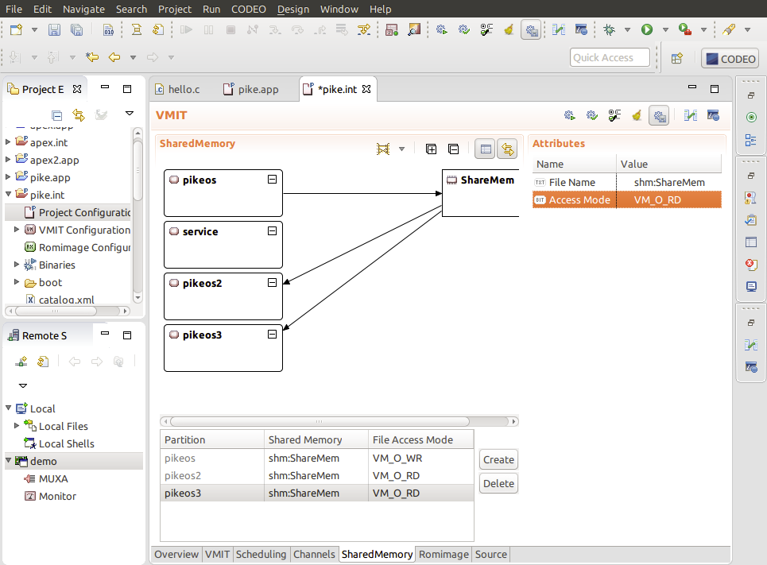
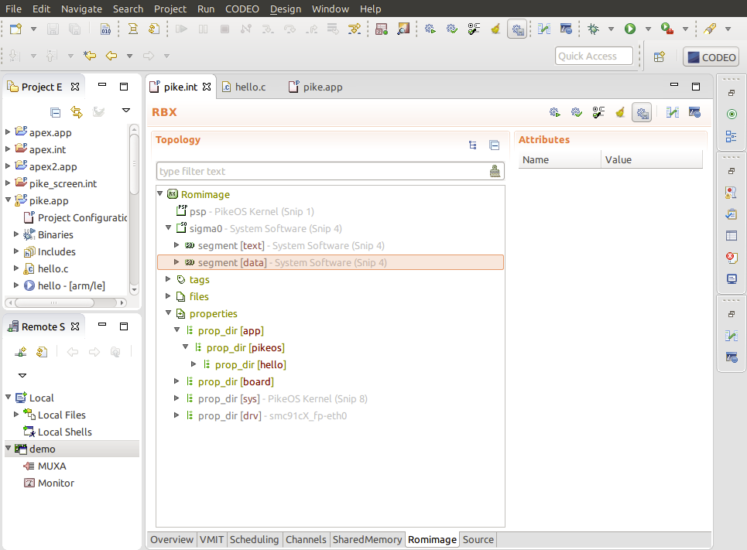
CODEO - Development Environment
System configuration
  General setup
  Resource partitioning
  Time partitioning and Scheduling
  IPC
Wizard to setup new projects or clone existing ones
Linux and Windows Hosts
Build your complete system (applications, configurations)
Notes:
Clone existing project
- use provided templates
16

Slide 17
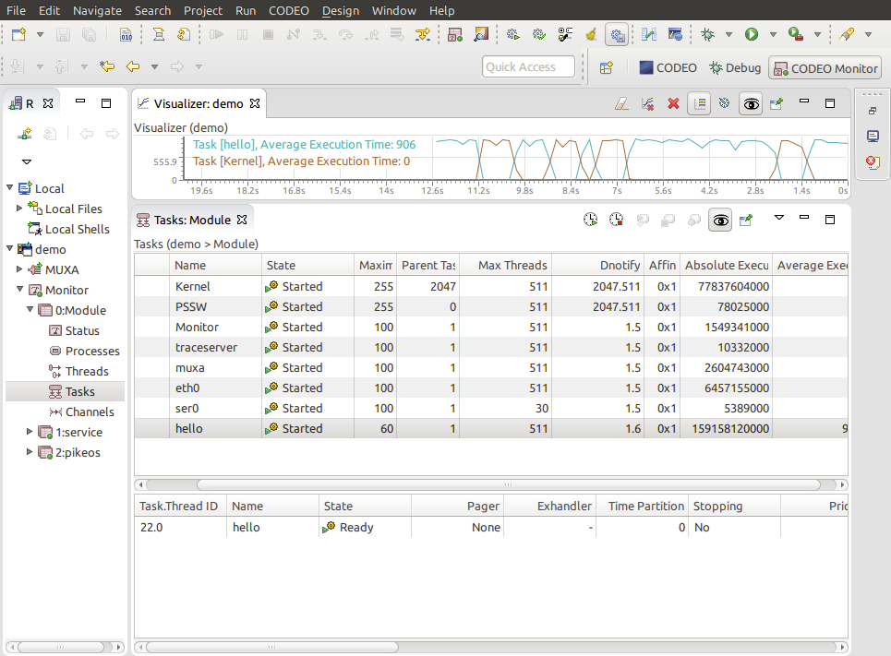
CODEO – Target System Viewer
Provide system status information
  Partitions
  Scheduling schemes
  Memory allocation
  Processes and threads
  Inter-partition communication
  Interrupts
  Semaphores
  Sockets
  …
Provide Functions to stop, start and reset partitions on the fly
Notes:
Monitor all key parameters of target system in real time

Slide 18
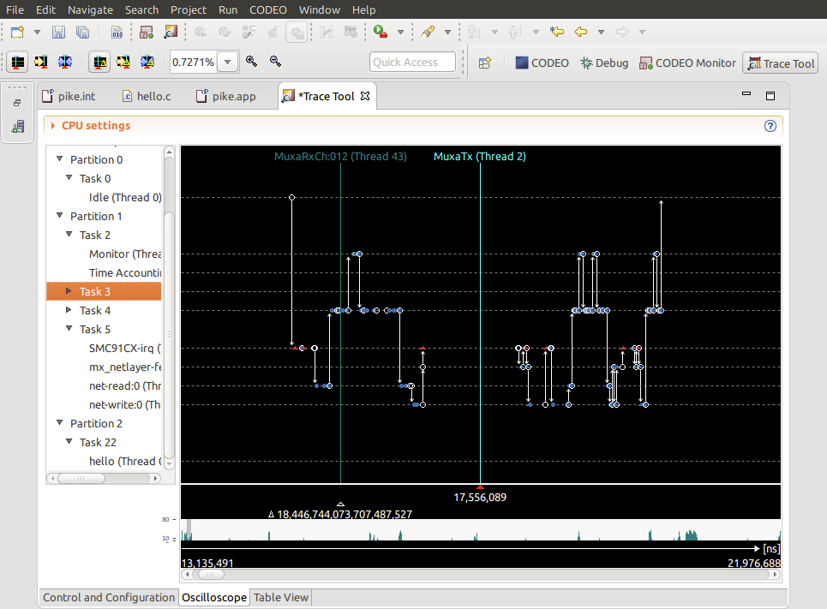
CODEO – Tracing of Target System
Precise timing analyses of system and application behavior
Graphical and numerical representation of trace results
Easy filter and trigger definition
Results can be exported
Notes:
- In depth analysis of timing

Slide 19
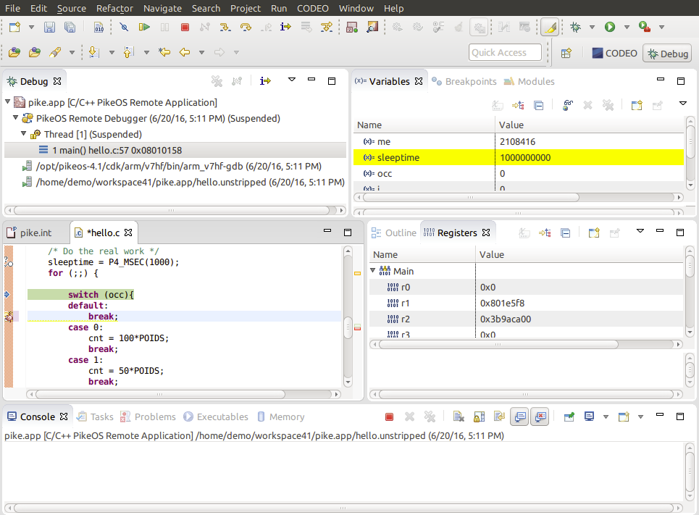
CODEO – Remote Debugging of Target System
Simultaneous multi application debugging
Multi-thread debugging
All functionality known
from gdb is available
  Break points
  Stack traces
  Step-by-step
  Exception handling
Notes:
Debugging: not only one but multiple applications
Based on well known and established standard gdb

Slide 20
PikeOS 4.2
Summary
SYSGO AG
2018

Slide 21
Summary - SYSGO makes the difference
Unique combination of product supplier and field application practitioner
  We know the embedded application development constraints and requirements from experience
Long track record of innovative solutions
  First to provide industrial grade embedded Linux
  First to provide certified embedded virtualization
  First to provide certified software based AFDX
Certification experts with international experience
  We know how safety certification standards as interpreted in Europe and in the US
  We are involved in the definition of international security standards
Notes:
Our long experience as service supplier gives us the necessary input to create top of class products
We do innovation but always by keeping in mind the industrial needs
Embedded Linux product (ELinOS) has been released one year before MontaVista and TimeSys (the other ones- FSMlabs, Hard Hat were more academic at the beginning)
PikeOS differentiates from VxWorks 653 (not originally designed for virtualization), Interity Padded Cell (just an add-on to Integrity), LynxOS SE (another layer on top of regular LynxOS and different from certified LynxOS 178)
DO-178B is sometimes interpreted differently bt the FAA or the EASA (ex: RSC – Reusable Software Component - from LynuxWorks is not accepted in Europe)

Slide 22
Summary – PikeOS the Platform RTOS
Hard Realtime
  PikeOS bootup < 30ms
  Guest OS (e.g. POSIX) up after 100ms
  Minimum memory consumption (++256kB RAM)‏
Scalable Configuration
  Small RTOS
  Highly Integrated: Real-time + Multicore + Virtualization
  Linux Software Eco-System
Certified to several Safety and Security Standards
Only hypervisor certified for both safety and security

Slide 23
Thank you for your attention!
More information on www.sysgo.com

